Slide 1
Project 6 Data Journalism: Tell a data-driven long-form story
Group Member: Stian Kallevik
Xiaoxue Wang

Slide 2


Introduction
Why did we choose this project?
Visualization
Integration
Message
Audience
Climate Change is Emergency

Slide 3

Method
Tools
Program
Trello
Github
Discord
Html
Javascript
Css
Python
How can we organize our project？
Work Flow
Library
Regular Meeting
Division of labor
Share idea
P5.js
Pandas

Slide 4
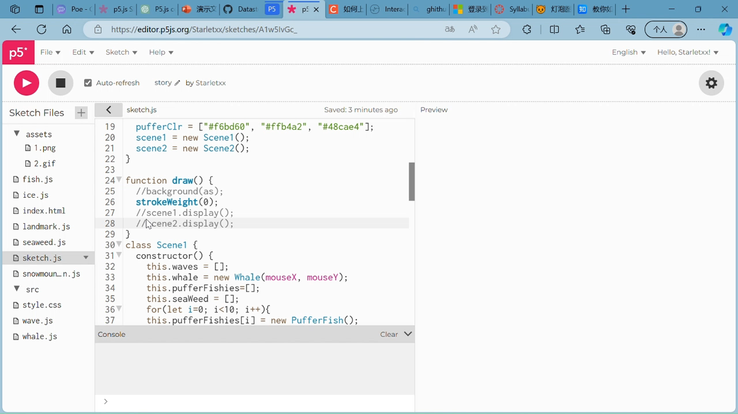
Demo-Story

Slide 5
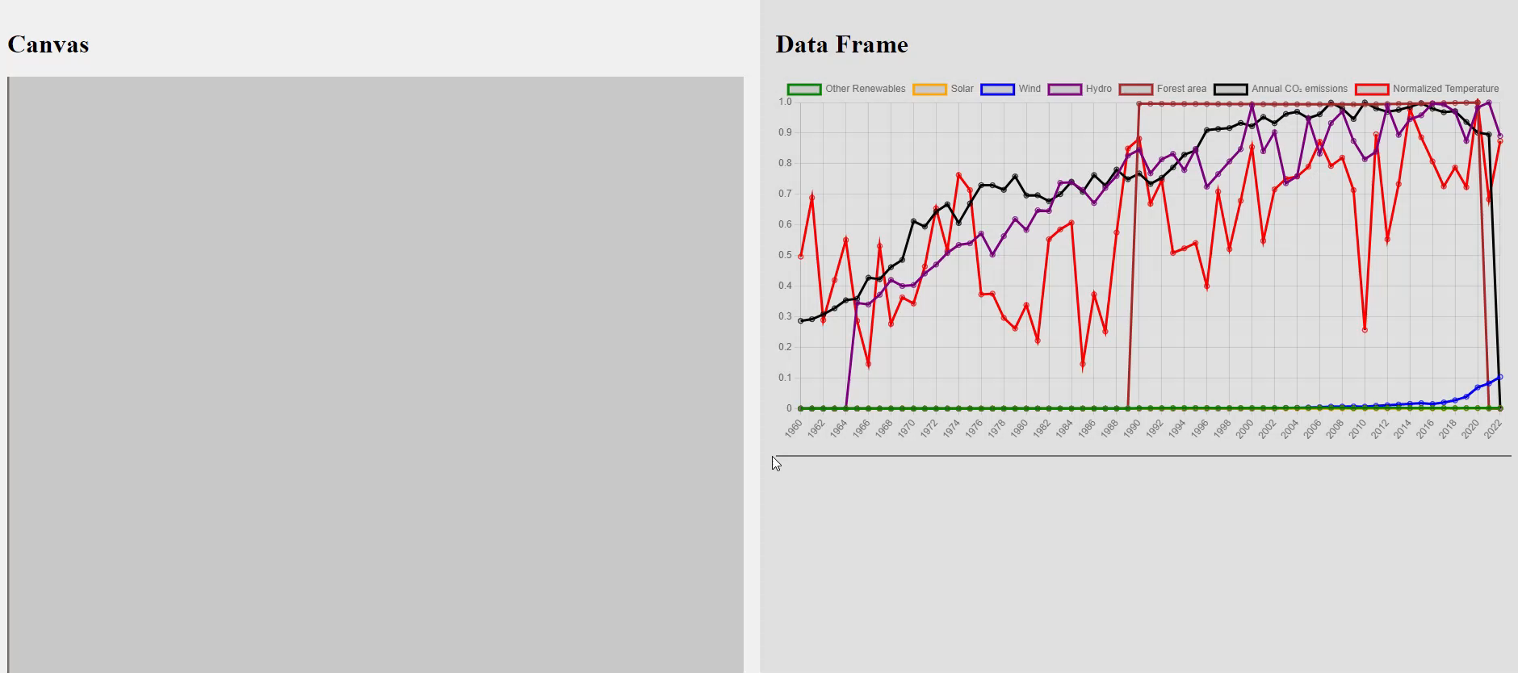
Demo-Data

Slide 6
Challenges
Group setup
Time constraint – started the project later.
Data collection
Some data is much easier to find than other data.
Data visualization
It takes a lot of work/time to get the dataflow going to the canvas.

Slide 7
Summary
What have been done so far:
Discussed and selected a message for the story
Collected data
Designed and set up an architecture for the code
Pre-process data and show it in the graph.
Made sketches of the story.
What are the next steps:
Get the data pipeline ready so it is possible to test and implement the code for the canvas/picture.
Reconsider how the data is used in the graph. We need to make sure it makes sense for all the data to be normalized in the same graph. For instance, temperature and annual co2 emissions could be better to have in separate graphs.
Continue to develop the Minimum Viable Product

Slide 8

Thank you for your attention!
Group Member: Stian Kallevik
Xiaoxue Wang

